Slide 1
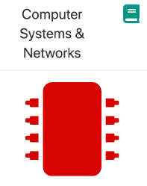
Welcome!!
Thursday 23rd May, 2024

Slide 2
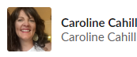
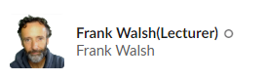
Computer Systems & Networks
Caroline Cahill
caroline.cahill@setu.ie
Dr Frank Walsh
frank.w.walsh@setu.ie

Slide 3
Computer Systems & Networks
10 Credit
Module delivery split between Frank & Caroline
Timetabled for TWO sessions per week

Slide 4
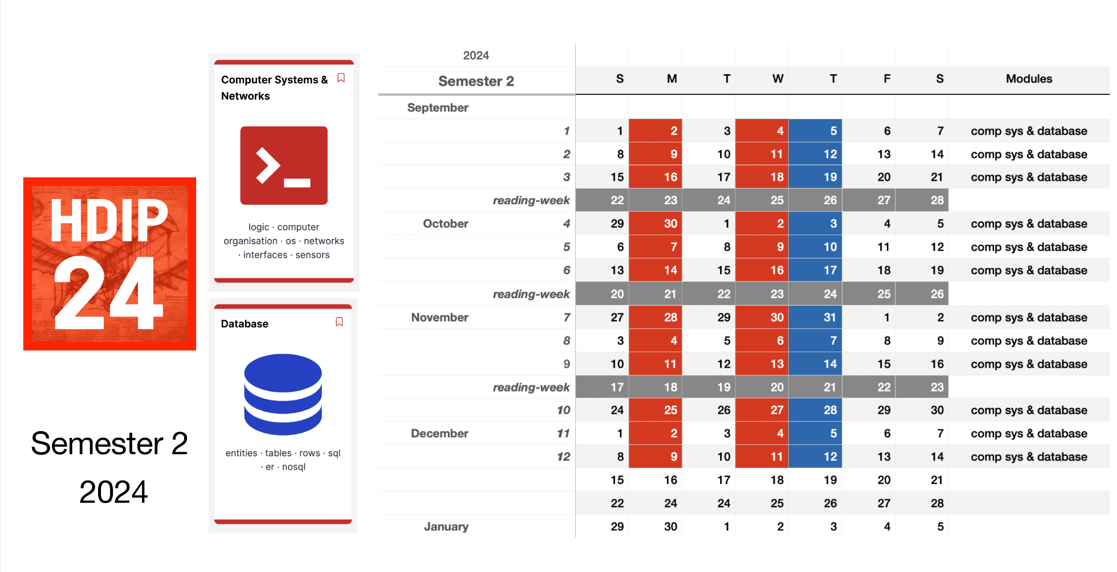

Slide 5
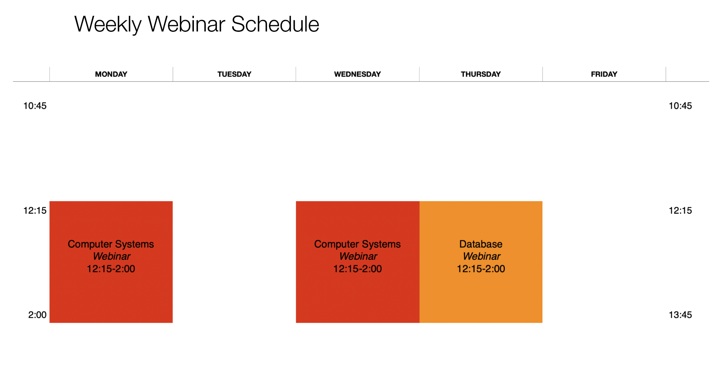
Notes:
Sometimes you might need to watch video, read article before lecture. - Same as programming.
Lectures are a mix of live and pre-recorded.
Labs every week (practical skills module) . Build something.

Slide 6
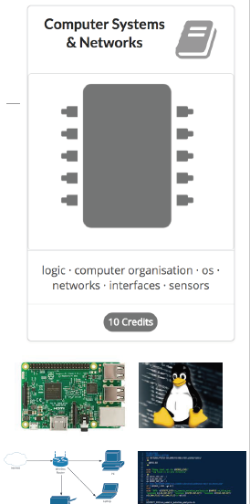
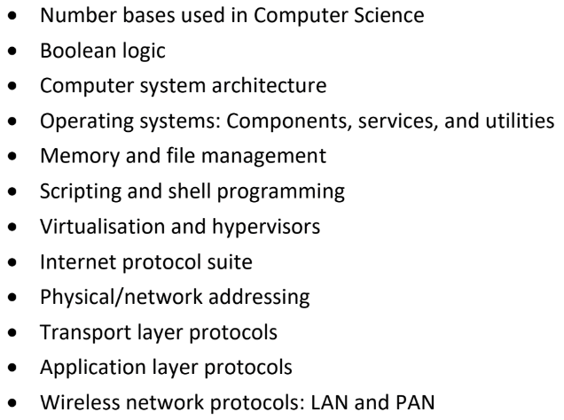
Module Overview: (Available on Handbook)
Notes:
Generally split into two parts: - Computer Systems (Caroline) - Networks (Frank) - Computer systems
Networking: protocols and function of computer networks – how the internet works.
Through the lense of the Internet of Things.

Slide 7



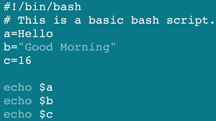
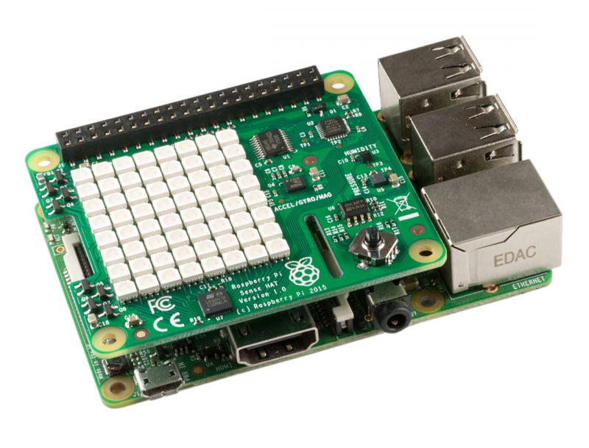


Development Tech (tentative)

Slide 8

Cisco NetAcad
You will complete up to and including Module 11

Slide 9
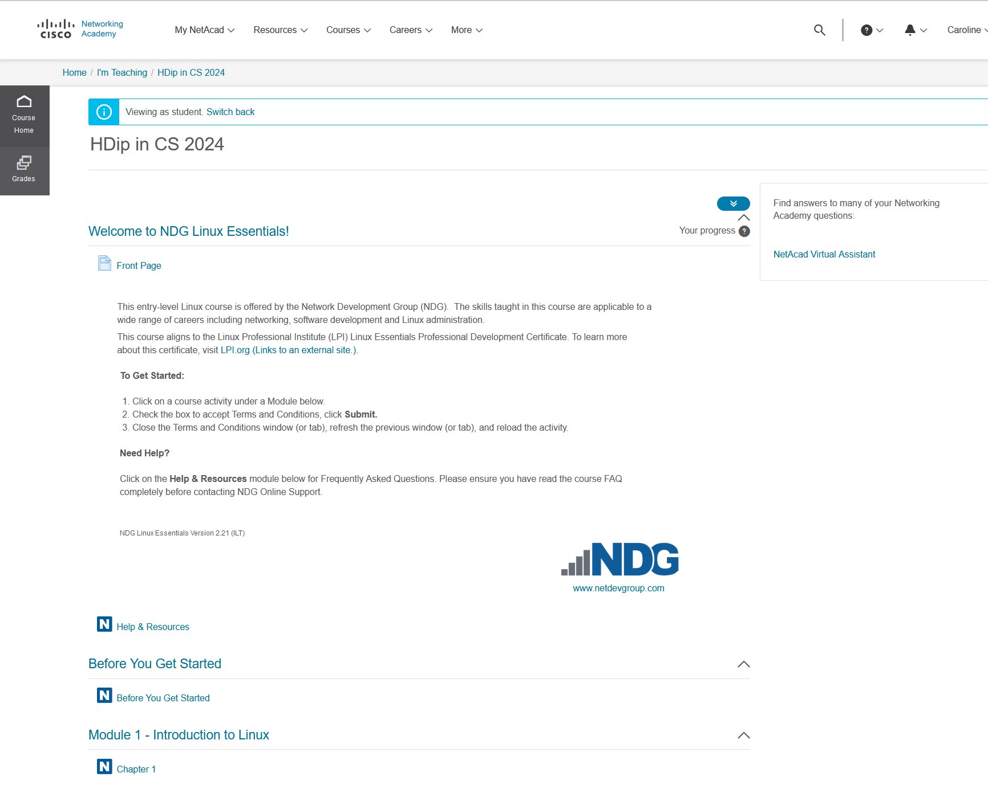
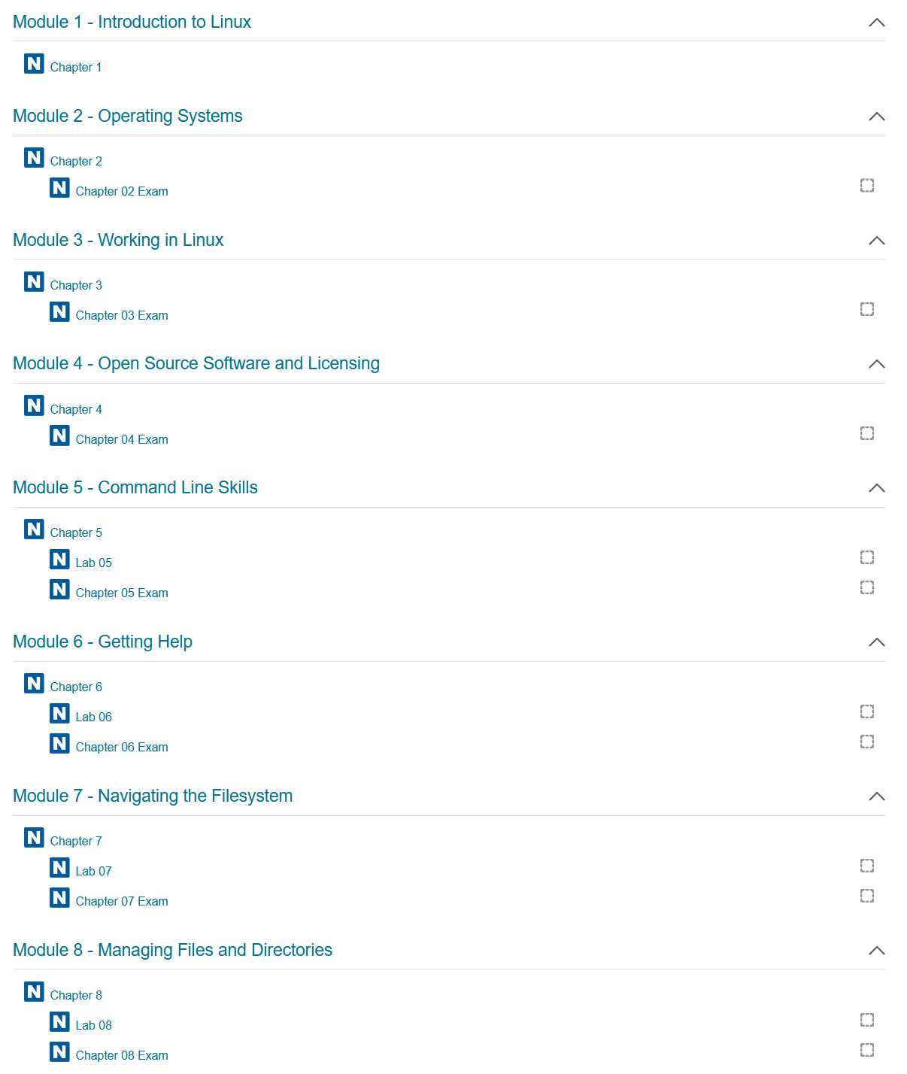

Slide 10
Using Linux
You could use any emulator/any virtualiser software & then install Linux on top of this
(= keeps your Linux completely separate from your work system)
You could install VirtualBox & then install Lubuntu onto this
VirtualBox also won’t install on a M1/M2 chip as they removed support for it
You can use a UTM virtualiser (was created for macOS & only for Apple platforms)
You can install Lubuntu on a Raspberry Pi (the SD card will hold everything)
You can use WSL (windows subsystem for linux)
If using a Mac, the standard Mac terminal will be perfect
NOTE: If you use the mac terminal then you are working and making changes to your actual OS
My screenshots in the notes will be taken off my own Lubuntu that I've installed in VirtualBox

Slide 11

Assignment Structure
100% Continuous Assessment
35% Assignment 1/ Labs
Computer Systems/Operating Systems
65% Assignment 2 / Networking Exercises
Networking/Devices

Slide 12
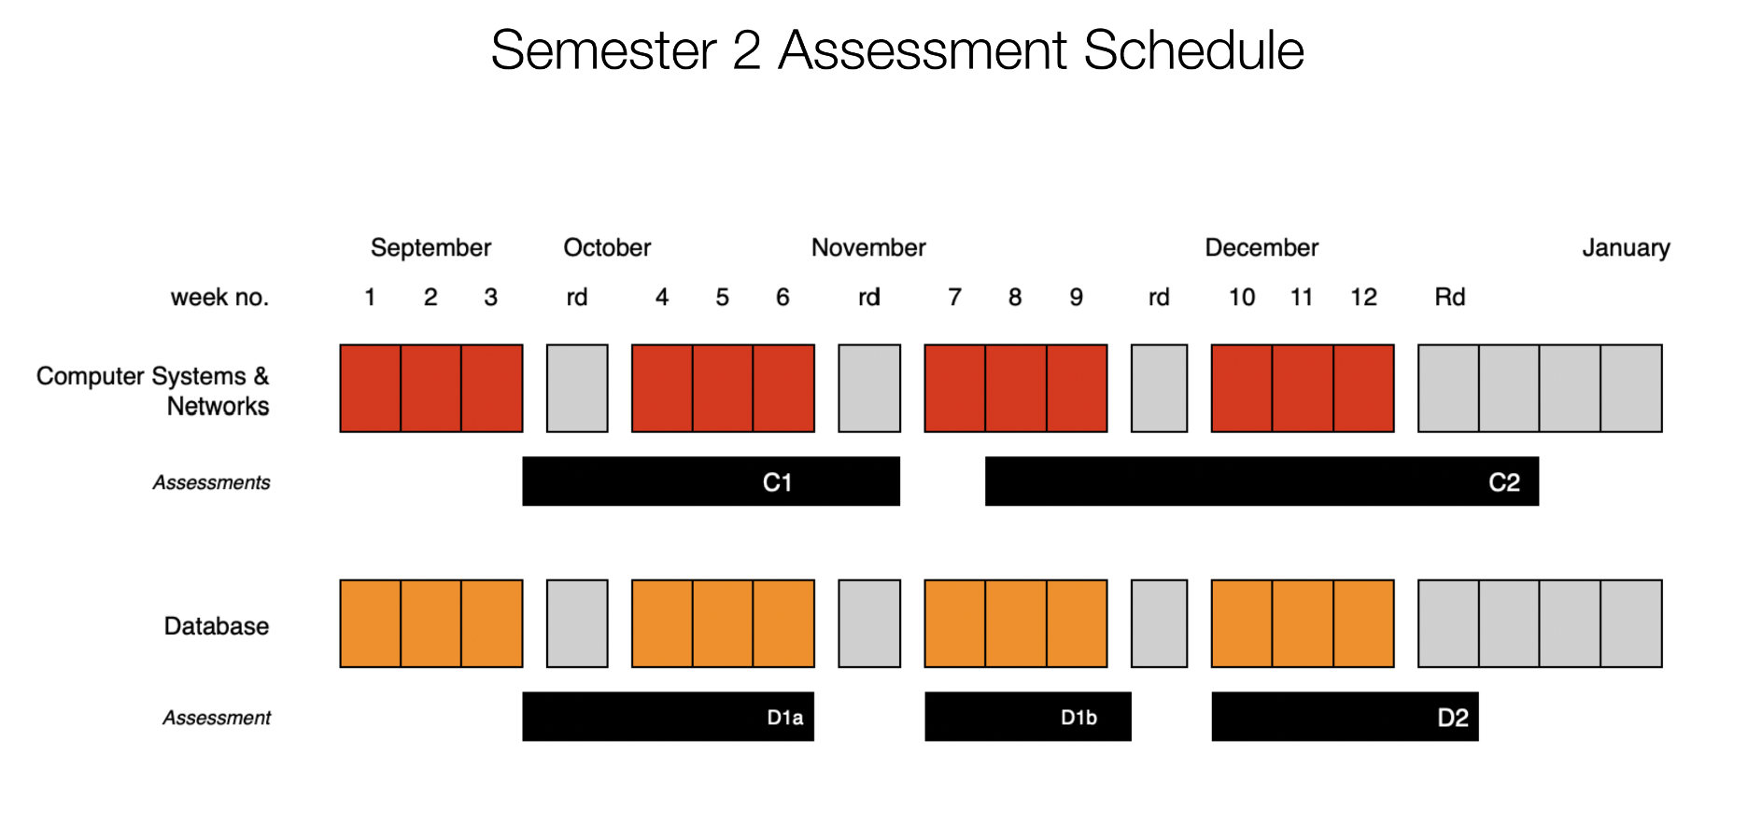

Slide 13
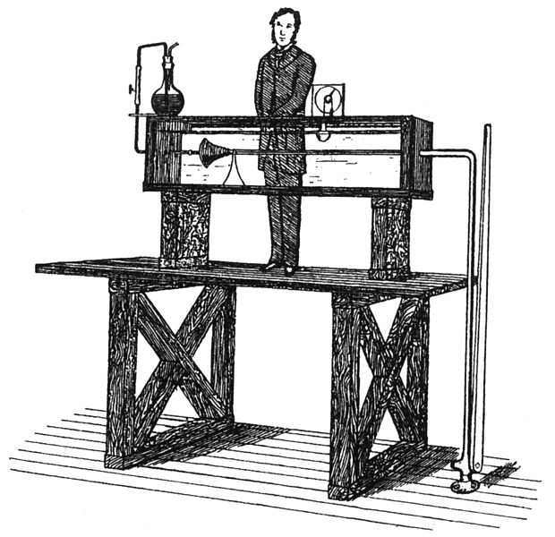
Ethos
Focus on practical skills
Good idea to stay current with module:
Some lectures will require reading/viewing of talks before.
Experiment/build something interesting:
You will have the opportunity to propose your own assignment!

Slide 14

Which will you use?

Slide 15
Linux Basics: Linus IS case sensitive
Caroline.txt is not the same as caroline.txt
File & Directory naming conventions (NO SPACES!!!)
CarolineCahill is a good filename i.e. capitalising the first letter of each word
The Linux prompt (Shell prompt) ends with a $ when logged in as a regular user

Slide 16
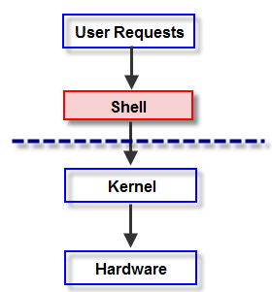
The Shell
In Linux, the shell is
a program that interprets commands
acts as an intermediary between the user and the inner workings of the OS

Slide 17
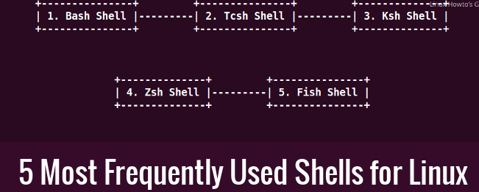
Which Shell is your system using?
Try out what happens if you type “echo $shell”
Find your system default by echoing the variable:
echo $SHELL
To close a shell, simply type:
exit

Slide 18
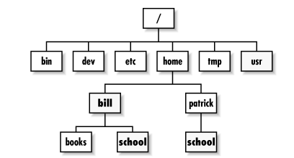
Directory Tree Structure
Type the ls command

Slide 19
Directory Tree Structure: what does yours look like?
Based on this hierarchy, can you
visualise how your filesystem looks?

Slide 20
Basic file & directory exercise
From home, create a new directory called OnSiteSETU
$mkdir OnSiteSETU
Inside this OnSiteSETU directory, create two subdirectories caroline and frank using the same mkdir command
Check they’re actually created.. [HOW??]

Slide 21
Solution:
home
OnSiteSETU
caroline
frank
tempAnyFile
Create another subdirectory tempAnyFile inside the frank directory

Slide 22

Type $cd ../ to return home
how can you check that you’re home?
From home, delete(remove) the empty caroline directory using the rm command
Do you get an error? Try adding the –r argument
$rm –r caroline
Check it’s removed … how?
3. From here, check that the tempAnyFile exists using
$ls frank

Slide 23


Command Manual
Every command has it’s own manual page
man <<command>>
Try it out:

Slide 24
Don’t forget Linux IS case sensitive!!!
$cd usr
IS NOT THE SAME AS
$cd Usr
Be mindful with creating names - make good use of $ls to view your directory names

